Slide 1
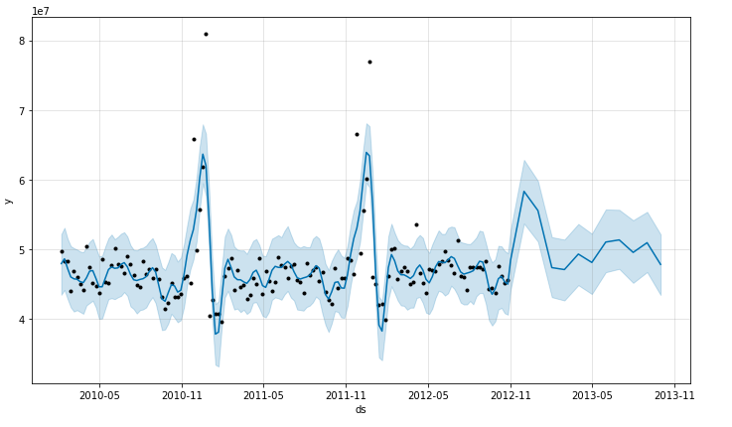
SALES FORECAST MODEL

